Slide 1
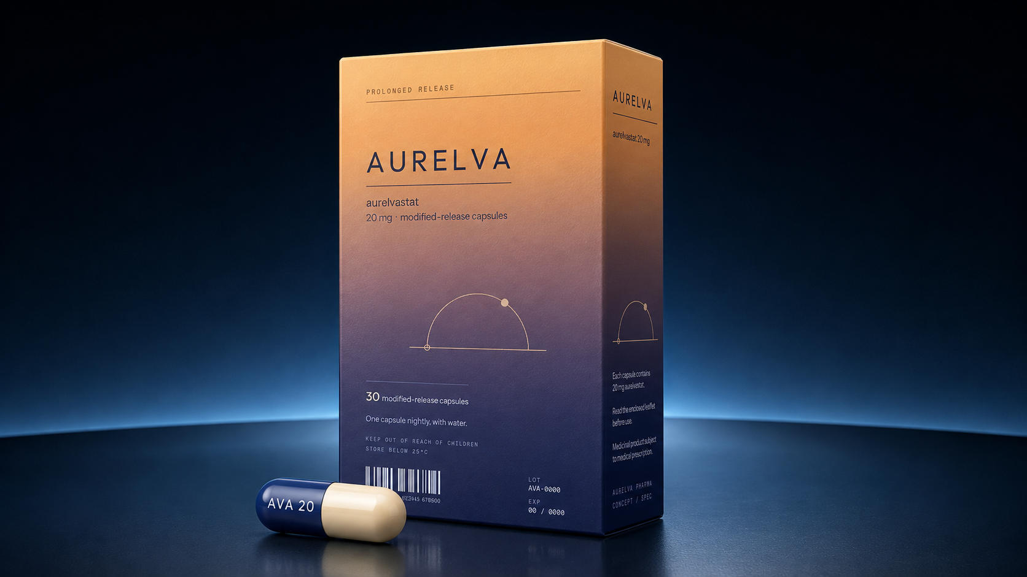

AURELVA
aurelvastat 20 mg · modified-release capsules
Scientific Overview
Internal briefing — Medical & Scientific Affairs
Nocturnal Inflammatory Stiffness (NIS)
AURELVA is a fictional product created for demonstration purposes. No such medicine, molecule, or clinical programme exists.
01
Notes:
Fictional product deck built as a capability demonstration. Open by stating clearly that AURELVA does not exist.

Slide 2
ABOUT THIS DOCUMENT
This product does not exist
What this is
Why it is fictional
What to evaluate
A complete fictional pharmaceutical brand — condition, molecule, formulation, clinical narrative, packaging, and film — built end to end to demonstrate production capability.
Building on a real product would require regulatory review, medical-legal sign-off, and client data. A fictional brand demonstrates the same craft with none of the risk.
Scientific plausibility, visual accuracy of the mechanism sequences, packaging fidelity, and whether the register is right for an internal audience.
Every slide in this deck carries the same notice.
AURELVA is a fictional product created for demonstration purposes. No such medicine, molecule, or clinical programme exists.
02

Slide 3
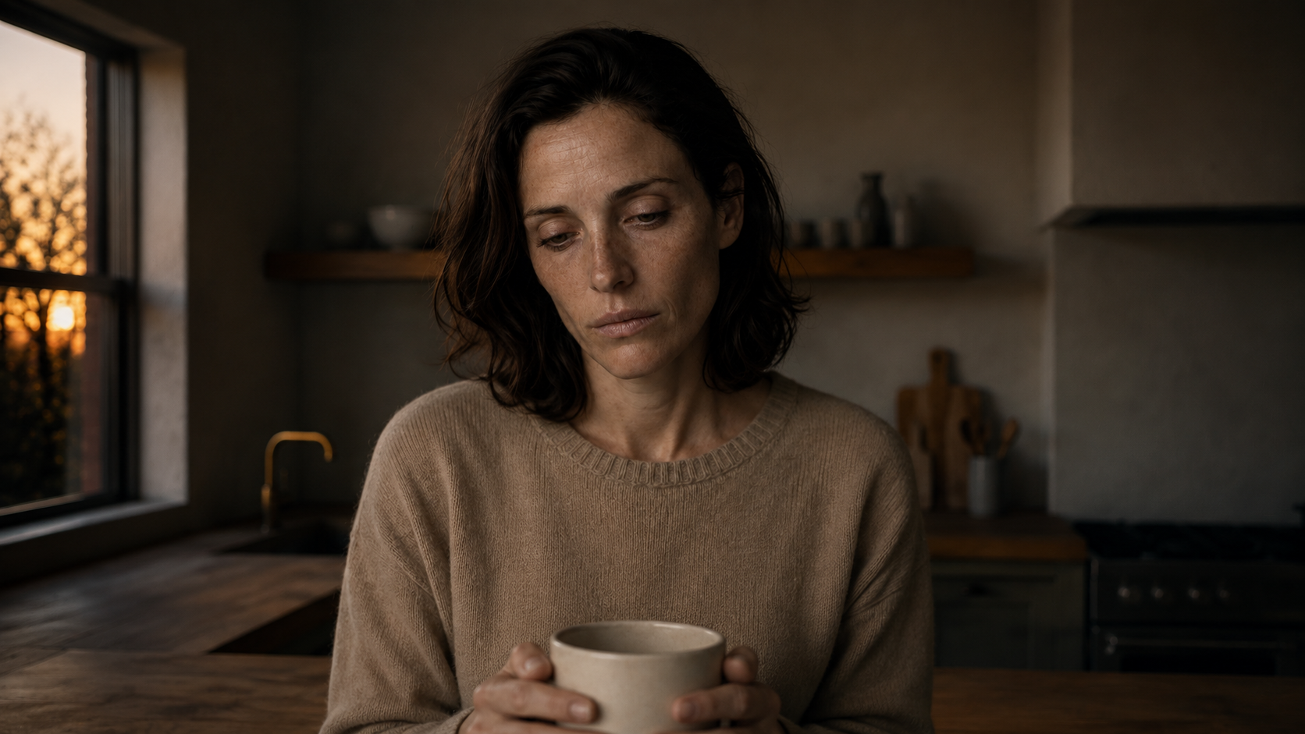
THE CONDITION
Nocturnal Inflammatory
Stiffness
An inflammatory joint condition in which the flare cycle peaks during sleep. Inflammatory mediators accumulate in the joint capsule overnight while the body is at rest, so patients wake at their symptomatic worst.
Onset
Symptoms build through the sleep period, independent of daytime activity
Peak
First 60–90 minutes after waking — grip strength and fine motor function most affected
Resolution
Eases with movement through the morning, then rebuilds the following night
AURELVA is a fictional product created for demonstration purposes. No such medicine, molecule, or clinical programme exists.
03

Slide 4
DISEASE BURDEN
The first hour of the day is the hardest one
2.8M
71%
68
3.4×
adults affected
in the US
report morning stiffness
exceeding 45 minutes
median minutes to
functional grip strength
higher rate of reduced
work productivity
Figures are illustrative and invented for this demonstration.
AURELVA is a fictional product created for demonstration purposes. No such medicine, molecule, or clinical programme exists.
04

Slide 5
UNMET NEED
Existing options are timed for the wrong part of the day
Current standard
Design target
Daytime dosing, peak exposure mid-morning
Onset after symptoms have already peaked
Patients pre-dose on waking and wait
Overnight accumulation left untreated
Once-nightly dosing aligned to the flare cycle
Sustained exposure across the sleep period
Therapeutic concentration present at waking
No morning dosing step for stiff hands
AURELVA is a fictional product created for demonstration purposes. No such medicine, molecule, or clinical programme exists.
05

Slide 6
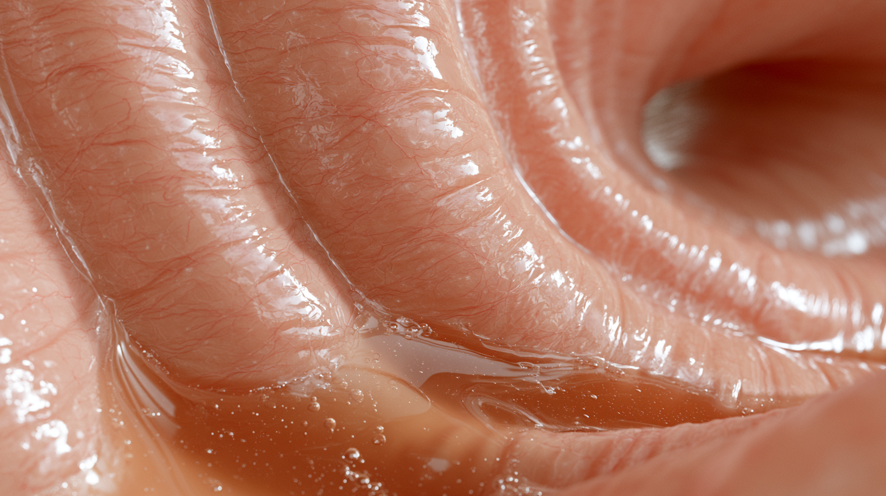
MECHANISM OF ACTION
Released slowly, delivered overnight
01
02
03
04
Dissolution
Absorption
Distribution
Inhibition
Enteric-coated microspheres release from the capsule shell in the stomach over an extended window
Sustained absorption across the intestinal epithelium maintains plasma levels through the sleep period
Aurelvastat partitions into synovial tissue, reaching the joint capsule during the overnight flare
Selective binding suppresses the mediator cascade driving overnight inflammatory accumulation
AURELVA is a fictional product created for demonstration purposes. No such medicine, molecule, or clinical programme exists.
06

Slide 7
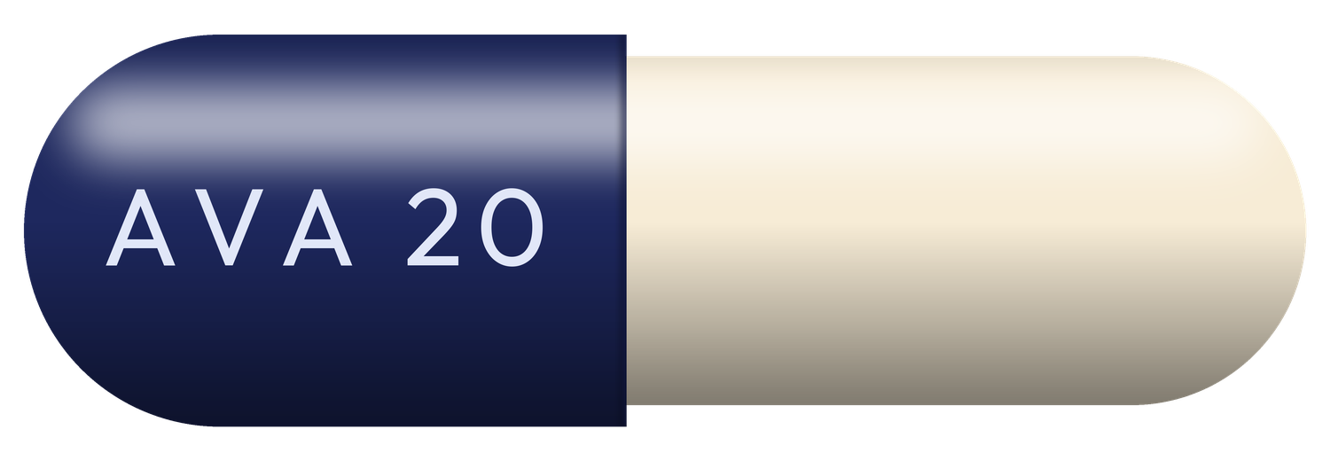
FORMULATION
Why modified release
Immediate release
Peak at 1–2 h, trough before waking. Exposure is highest when the patient is asleep and symptom-free.
Modified release
Coated microspheres release across 8–10 h, holding concentration through the flare window and into waking.
Dosing consequence
Two-piece hard capsule · indigo cap, translucent cream body · imprint AVA 20
One capsule nightly. No morning administration step — relevant when grip and fine motor function are impaired.
AURELVA is a fictional product created for demonstration purposes. No such medicine, molecule, or clinical programme exists.
07

Slide 8
PHARMACOKINETICS
Simulated overnight plasma profile
Sleep window
Concentration is held above the modelled threshold from hour 2 through hour 11, covering the overnight accumulation period and remaining present at waking.
Simulated data. Illustrative only.
AURELVA is a fictional product created for demonstration purposes. No such medicine, molecule, or clinical programme exists.
08

Slide 9
CLINICAL PROGRAMME
Development pathway
Phase I
Phase II
Phase IIb
Phase III
n = 64
n = 312
n = 486
n = 1,240
Safety, tolerability, and dose-ranging in healthy volunteers
Dose selection across 10 mg and 20 mg against placebo
Confirmatory dose, extended 24-week exposure
Two pivotal trials, primary endpoint at week 12
Programme structure is invented for this demonstration.
AURELVA is a fictional product created for demonstration purposes. No such medicine, molecule, or clinical programme exists.
09

Slide 10
PRIMARY ENDPOINT
Change in morning stiffness duration
Effect size
Both active arms separated from placebo by week 4 and sustained separation through week 12.
Dose response
A clear gradient between 10 mg and 20 mg supported 20 mg as the confirmatory dose.
Secondary
Grip strength and patient-reported function moved in the same direction.
Simulated results. Invented for this demonstration.
AURELVA is a fictional product created for demonstration purposes. No such medicine, molecule, or clinical programme exists.
10

Slide 11
SAFETY
Tolerability summary
ADVERSE EVENT
AURELVA 20 MG
PLACEBO
Headache
6.2%
5.1%
Nausea
4.8%
3.9%
Dizziness, mild
3.1%
2.4%
ALT elevation > 3× ULN
1.4%
0.6%
Serious infection
0.7%
0.5%
Contraindicated in known hypersensitivity to aurelvastat. Hepatic monitoring at baseline, week 4, and week 12. Caution with concomitant anti-inflammatory therapy.
AURELVA is a fictional product created for demonstration purposes. No such medicine, molecule, or clinical programme exists.
11

Slide 12
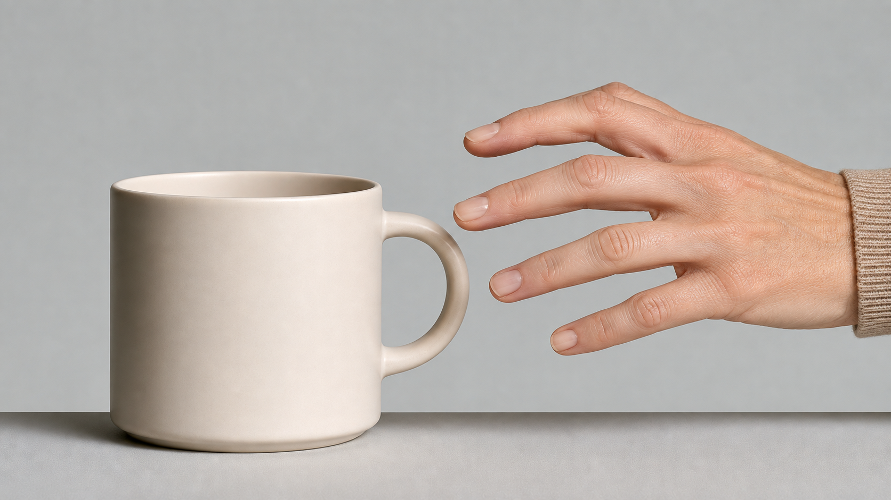
TARGET PATIENT
Who this is for
Adults with confirmed NIS whose symptom burden is concentrated in the first waking hour and who have not achieved adequate morning function on daytime-dosed therapy.
AGE
18 years and older
DIAGNOSIS
Confirmed NIS, symptom duration ≥ 6 months
SEVERITY
Morning stiffness ≥ 45 minutes on most days
PRIOR THERAPY
Inadequate response to at least one daytime-dosed agent
HEPATIC
Baseline ALT within normal range
AURELVA is a fictional product created for demonstration purposes. No such medicine, molecule, or clinical programme exists.
12

Slide 13
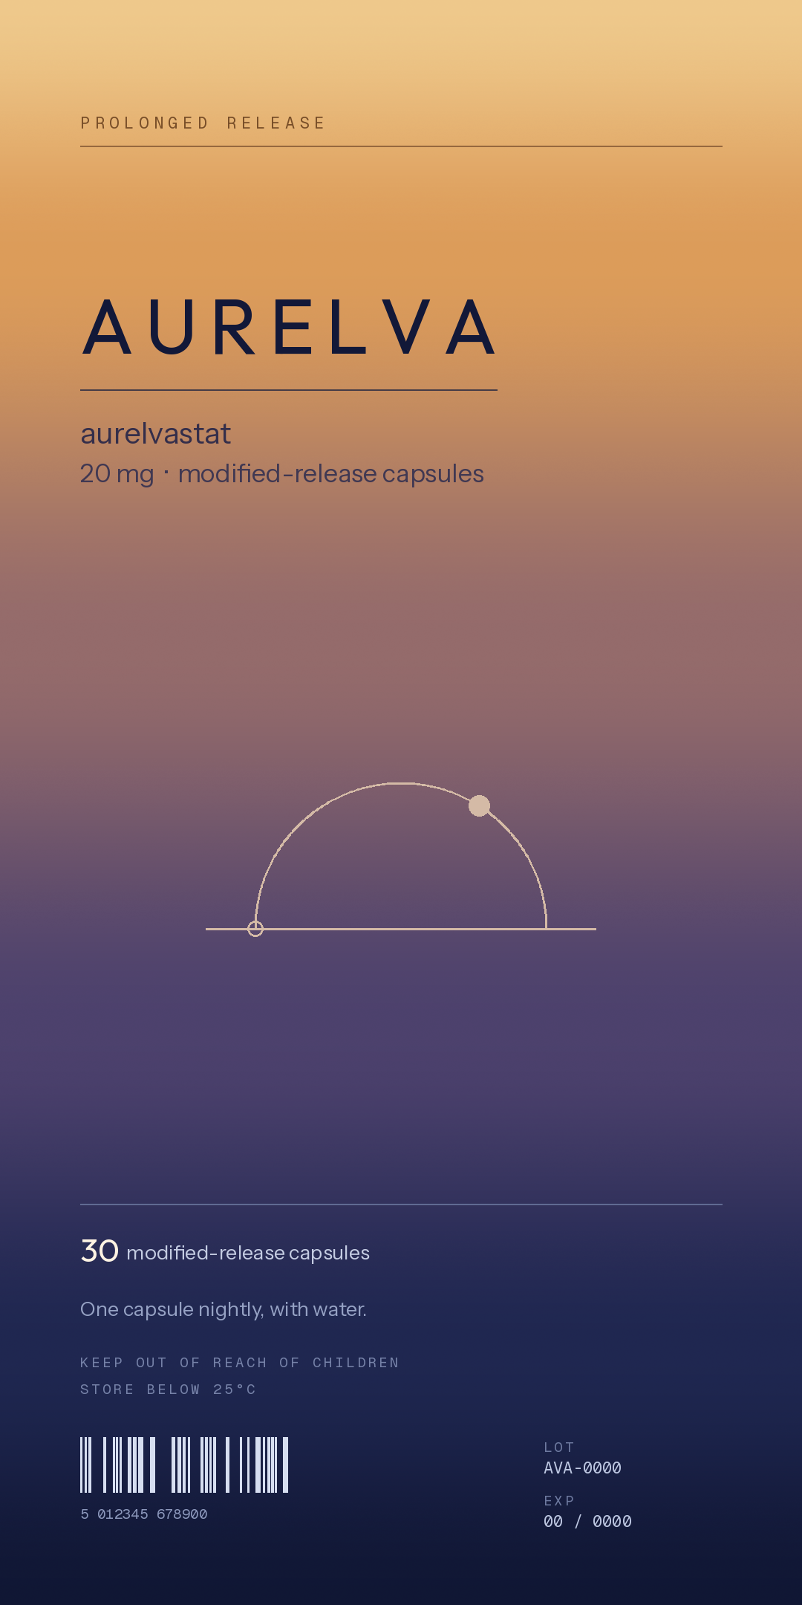
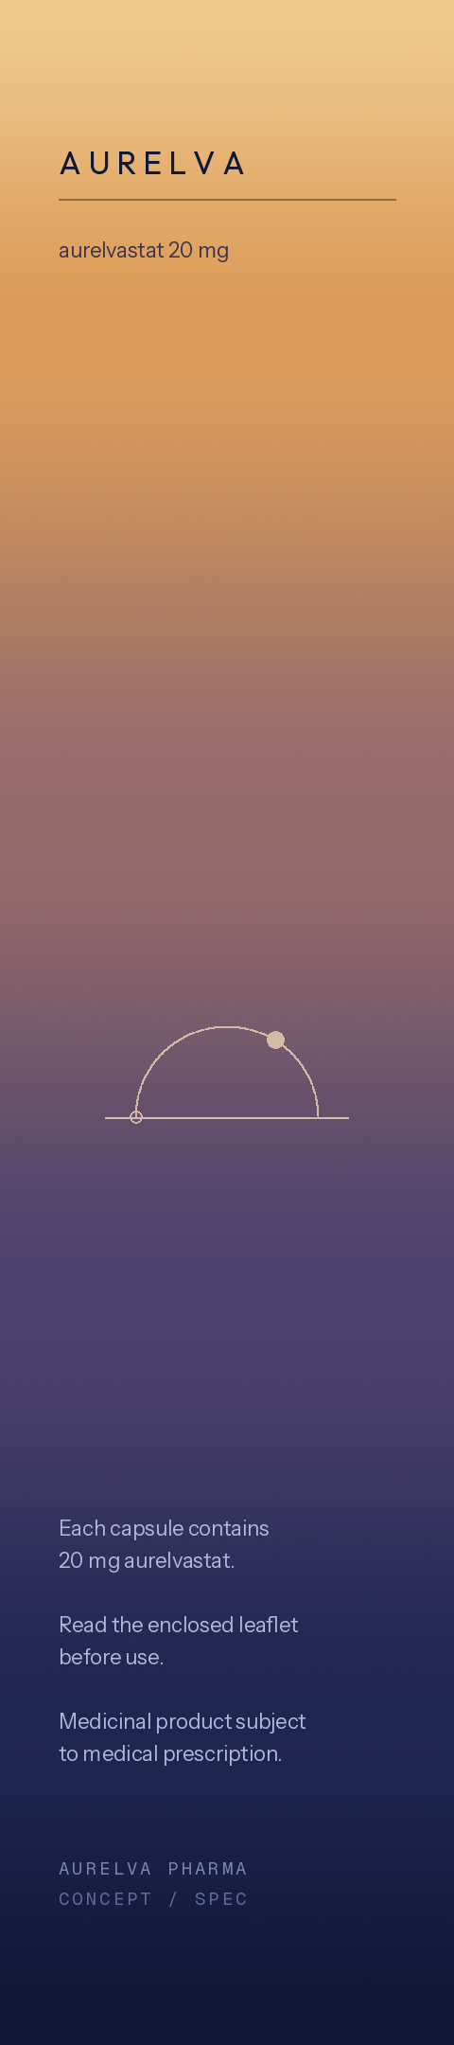
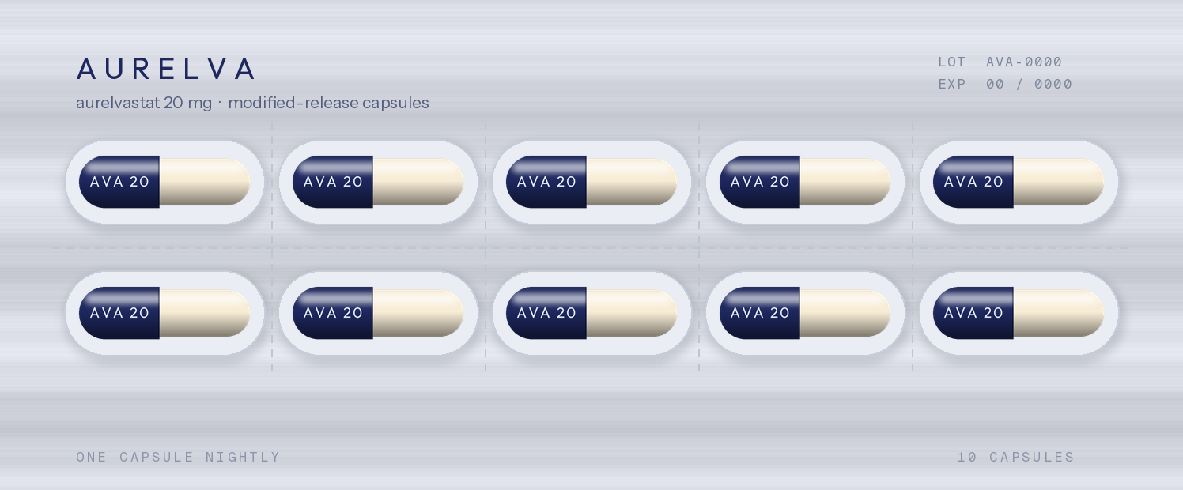
PRESENTATION
Packaging system
Colour system
A vertical gradient from deep indigo at the carton base to warm amber at the head — night into morning, carried across every surface.
Identity mark
Blister · 10 per strip, 3 strips
A horizon with a rising disc. Legible at blister scale and at pack-shot scale without redrawing.
Typographic hierarchy
Brand, generic name, and strength in descending weight; regulatory copy set in monospace to separate it from brand voice.
Capsule · imprint AVA 20
Carton · 45 × 90 × 20 mm
AURELVA is a fictional product created for demonstration purposes. No such medicine, molecule, or clinical programme exists.
13

Slide 14
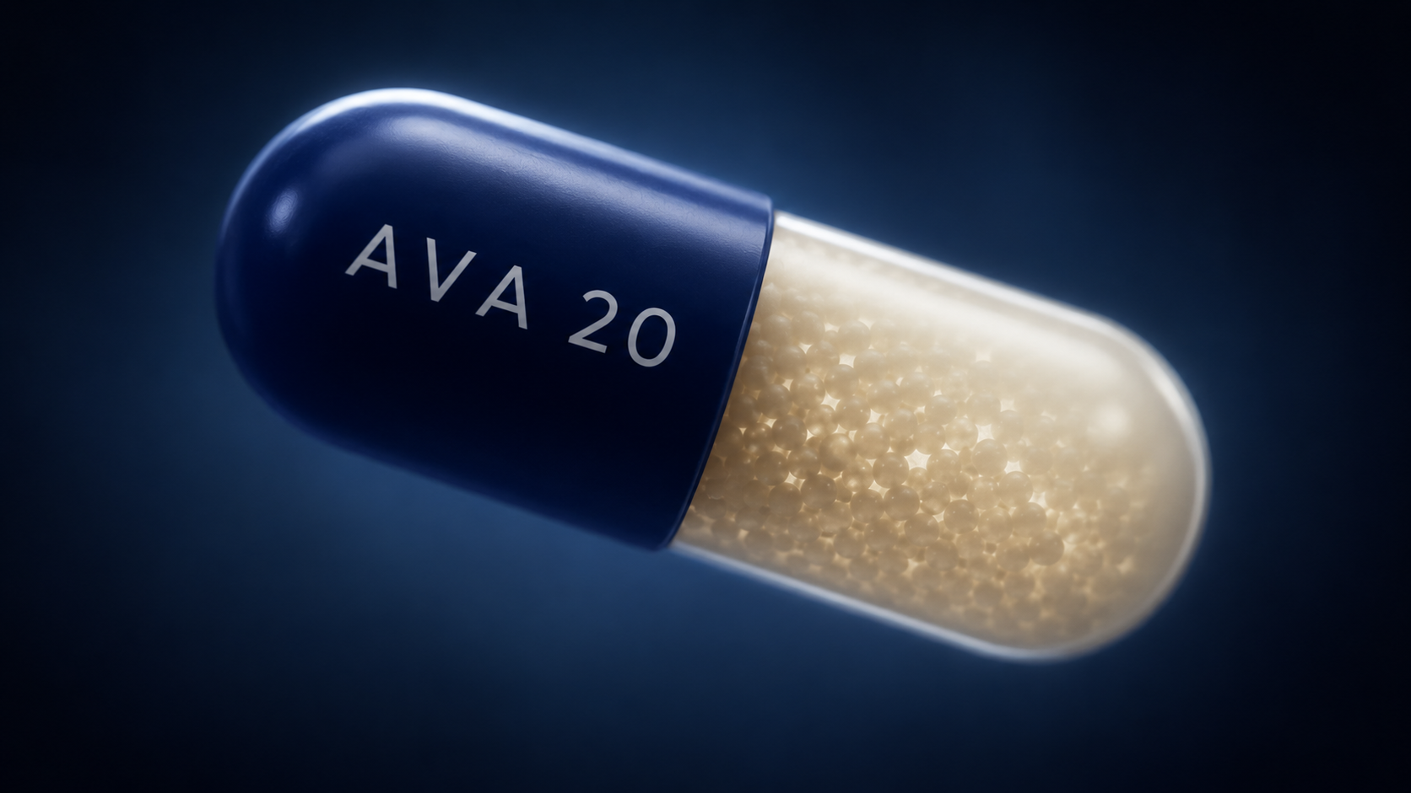
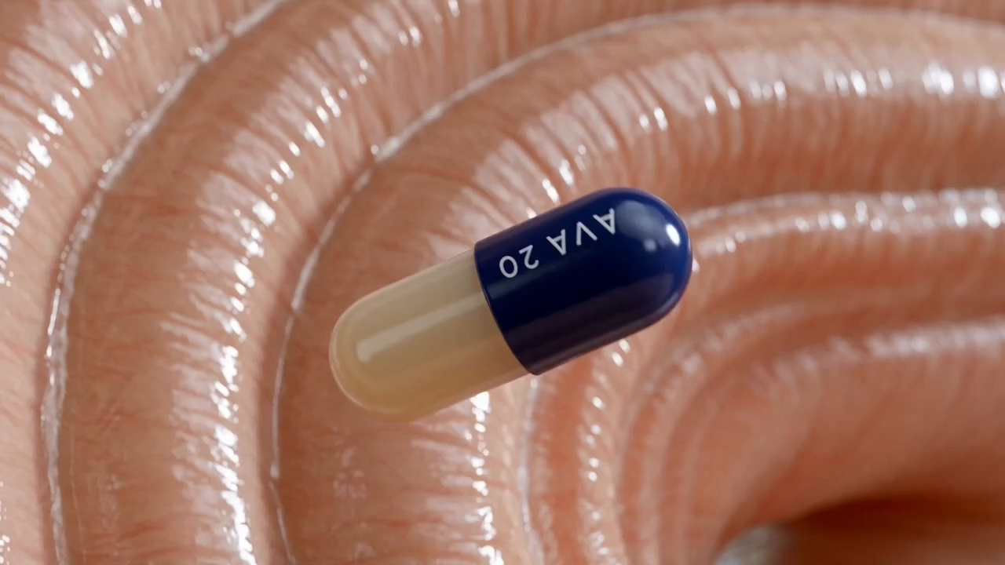
FILM 01
Mechanism of action sequence
Capsule dissolution, microsphere release, intestinal absorption, and distribution to the joint capsule. Rendered as continuous macro visualisation.
AURELVA is a fictional product created for demonstration purposes. No such medicine, molecule, or clinical programme exists.
14
Notes:
INSERT VIDEO HERE. In PowerPoint: Insert > Video > This Device, then size to the frame at x 3.55 y 1.85, w 6.2 h 3.49. Set Playback to Start Automatically. Delete the still and play-button shapes underneath once the video is placed.

Slide 15
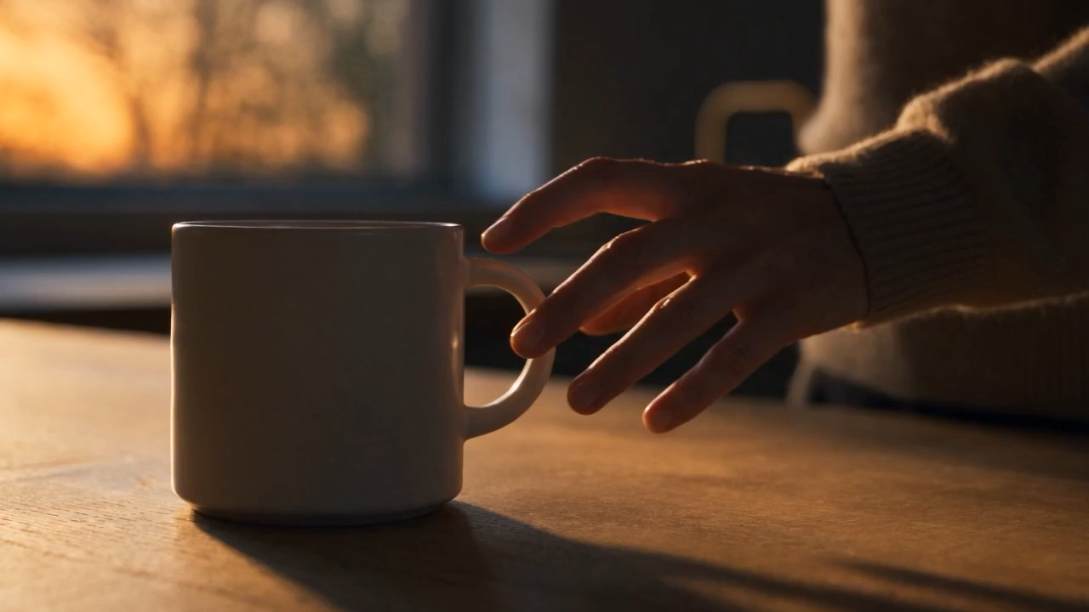
FILM 02
Direct-to-consumer spot - 30 seconds
“Mornings, Returned.” A patient narrative built around a single repeated action, with the mechanism sequence at its centre.
AURELVA is a fictional product created for demonstration purposes. No such medicine, molecule, or clinical programme exists.
15
Notes:
INSERT VIDEO HERE. Insert > Video > This Device, size to x 3.55 y 1.85, w 6.2 h 3.49. Set Playback to Start Automatically. Delete the still and play-button shapes underneath once placed.

Slide 16
AURELVA
Mornings, returned.
Concept, packaging, and film produced end to end as a demonstration of capability. AURELVA is not a real medicine.
AURELVA is a fictional product created for demonstration purposes. No such medicine, molecule, or clinical programme exists.
16

